Slide 1
REMOVAL OF WASTE
UNIT 1 ATAR Human Biological Science: Chapter 10

Slide 2
ELIMINATION
The removal of non metabolic waste faeces from the large intestine.
Non metabolic wastes – water, undigested food (soluble and insoluble fibre), bacteria, remains of cells.

Slide 3
EXCRETION
The removal of metabolic wastes before they can accumulate in body tissue and become toxic.
Excretory organs:
The lungs excrete carbon dioxide.
Liver.
Sweat glands largely secrete water for cooling, also excrete salts, urea and lactic acid
Alimentary canal excretes bile pigments
Kidneys (MAIN excretory organ) excrete toxic wastes such as nitrogenous wastes, urea, uric acid and creatinine.
Notes:
Metabolic waste – produced by chemical reactions that take place within the body

Slide 4
METABOLIC WASTES ORIGINS/ PROCESSES
Carbon dioxide is a metabolic waste as a result of cellular respiration.
Urea is the result of deamination (breakdown of proteins to amino acids) in the liver.
Bile pigments result from the break down of haemoglobin from dead erythrocytes.

Slide 5
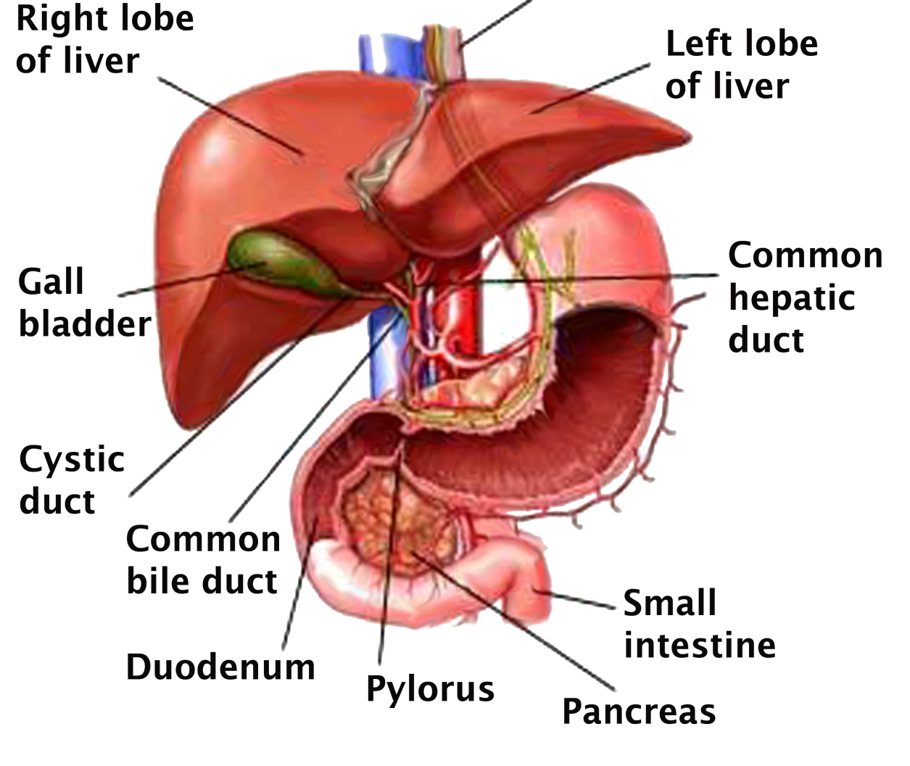
THE LIVER
Breaks down materials for excretion such as urea, hormones, Hb
Excess protein can’t be stored in cells, so needs to be removed from body.

Slide 6
THE LIVER: Deamination
Breaks down materials for excretion such as urea, hormones, Hb
Excess protein can’t be stored in cells, so needs to be removed from body.
Deamination – the conversion of amino acids into urea through enzymes and oxygen:
Amino acid + oxygen → NH₃ (ammonia) + carbohydrate
Carbohydrate broken down to release energy, CO₂ and H₂O
Ammonia is highly toxic, so readily converted to urea and excreted by kidneys and eliminated from body as urine OR excreted as sweat.
enzymes

Slide 7
THE LIVER: Detoxifier
Liver detoxifies alcohol and other drugs such as antibiotics.
Deactivates many hormones by converting them into a form to be excreted by kidneys.
Hb from dead RBC’s is broken down in liver to produce bile pigments.

Slide 8
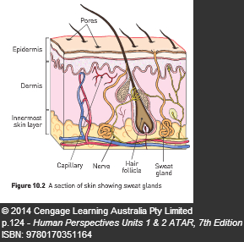
THE SKIN
Covers and protects the surface of the body, regulates temperature, excretory organ
Located within lower layers of skin are ducted sweat glands
Composition of sweat:
Secretes water via perspiration to cool body down
Contains lactic acid, salts and urea to be excreted as can become toxic.
May also contain some drugs to be excreted.

Slide 9
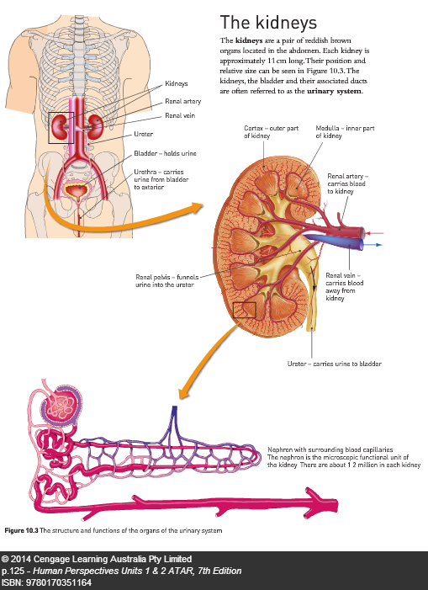
THE KIDNEY: Macroscopic
Kidney + bladder and associated ducts referred to as Urinary System

Slide 10
FUNCTIONS OF THE MACROSCOPIC STRUCTURE
Kidneys- maintain the homeostasis of materials within body fluids. For example, pH, lactic acid, urea.
Renal arteries- provide kidney tissue with oxygenated blood & nutrients.
Renal veins- provide a passage for blood leaving the kidneys. Removal of CO2 etc.
Renal pelvis funnels urine into the ureter
Ureter- carries urine from collecting tubules to the bladder for storage.

Slide 11
MACROSCOPIC STRUCTURE FUNCTIONS Cont...
Bladder- The ureter drains into the bladder; temporarily stores the urine.
Urethra- passage through which urine travels from the bladder to the external environment.
Renal capsule- outer layer of the kidney. It protects the kidney and helps to maintain the kidney's shape.

Slide 12
MACROSCOPIC STRUCTURE
Renal cortex- the outer (pale coloured) layer of the kidney. The process of filtration in the renal corpuscle occurs here.
Renal medulla- the middle, dark red, layer. The process of reabsorption occurs within the renal pyramids found in this part of the kidney.
Renal pelvis- funnel shaped upper end of ureter.

Slide 13
MACROSCOPIC STRUCTURE
Renal hilus- the part of the kidney that the renal artery enters & renal vein and ureter leaves.
Renal pyramids- triangular partitions in the renal medulla.
Renal papillae- white structures found at the tip of the renal pyramids.

Slide 14
MICROSCOPIC STRUCTURE -THE NEPHRON
Kidney composed of about 1.2 mill. nephrons (functional unit) and collecting ducts.
Where waste is removed from blood and blood composition is regulated, urine is formed here.
They are surrounded by capillaries.

Slide 15
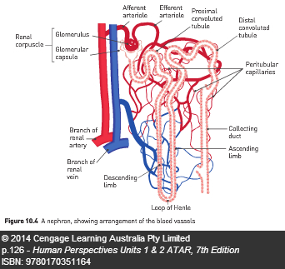
NEPHRON STRUCTURE
Each nephron consists of a renal corpuscle and renal tubule
The renal corpuscle is made up of the glomerular capsule (double walled cup-like structure) that surrounds a glomerulus (tightly coiled ball of arterial capillaries).

Slide 16
RENAL TUBULE
The renal tubule includes the proximal convoluted tubule, loop of Henle, distal convoluted tubule.
Convoluted tubules then drain into a collecting duct
The collecting duct drains into the renal pelvis which funnels urine into ureter.

Slide 17
NEPHRON BLOOD SUPPLY
The nephrons have a large blood supply. About 1.2 litres (600ml each kidney) per minute pass through.
The renal artery directly branches off the aorta thus allowing blood in the kidneys to be under high pressure.
The renal artery branches off into the arterioles such as the afferent and efferent arterioles.

Slide 18
RENAL CORPUSCLE BLOOD SUPPLY
An afferent arteriole leads into each glomerulus found within the renal corpuscle.
An efferent arteriole leads away from each glomerulus.
The afferent arteriole diameter is larger than the efferent arteriole diameter. This creates high pressure within the glomerulus, forcing water and dissolved molecules into the capsule.

Slide 19
RENAL TUBULE BLOOD SUPPLY
The efferent arteriole divides into peritubular capillaries which surround the proximal & distal convoluted tubules, the ascending and descending limbs of the loop of Henle, and collecting tubule.
This allows the surface of the renal tubule & peritubular capillaries to be in close proximity so that diffusion and active transport of substances into, and out of, the tubules can occur.

Slide 20
BLOOD LEAVING KIDNEYS
Venules drain blood from the peritubular capillaries into the renal vein leaving the kidney and directed to the inferior vena cava of the heart.

Slide 21
URINE FORMATION
Involves three processes called glomerular filtration, selective reabsorption and tubular secretion.
Glomerular filtration occurs in the renal corpuscle. Small molecules such as urea, water, salts, amino acids, fatty acids, glucose, uric acid, hormones, toxins, ions & creatinine pass through the capillary wall of the glomerulus, and through the glomerular capsule wall.

Slide 22
GLOMERULAR FILATRATION
When fluid is forced out of blood capillaries into glomerular capsule under high pressure.
Glomerular capillaries is separated from capsule by 2 layers of flat cells, allows water and dissolved blood parts (salts, amino acids, fatty acids, gylcerol, urea, uric acid, creatinine, hormones, toxins, ions) to diffuse through semi-permeable membranes into capsule.
Anything passing into the glomerular capsule becomes known as the filtrate.

Slide 23
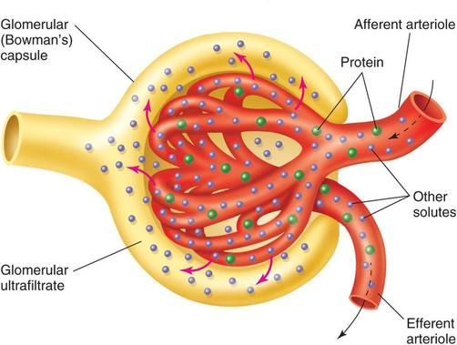
GLOMERULAR FILTRATION Cont...

Slide 24
GLOMERULAR FILTRATION Cont...
Large molecules in the blood (such as erythrocytes, leucocytes & other large proteins) of the glomerulus cannot pass through the capillary wall into the glomerular capsule.
20%of the plasma is filtered- blood is moving through too fast for all of it to be filtered. 180 litres is filtered per day.

Slide 25
SELECTIVE REABSORPTION
Selective reabsorption occurs in the renal tubule so that substances required by the body can be reabsorbed back into the blood and not excreted.
Glucose, water & amino acids are selectively reabsorbed through the proximal convoluted tubule & capillary wall lining cells back into the blood.
Many tubules and long length provide large surface area for effective reabsorption.

Slide 26
SELECTIVE REABSORPTION
Ions such as sodium, potassium, calcium chloride & bicarbonate are reabsorbed.
Facultative reabsorption is able to occur depending on the body's water requirements.
Facultative reabsorption of water through the distal convoluted tubule & collecting duct wall can occur when the hormone, antidiuretic hormone (ADH), changes the permeability of the wall to allow the active transport of needed water into capillaries.

Slide 27
SELECTIVE REABSORPTION-STILL
Wastes like urea are partially reabsorbed
The long structure of the renal tubule & many surrounding capillaries provides a large surface area for reabsorption.

Slide 28
TUBULAR SECRETION
Is the final process involved in urine production.
It involves adding substances to the filtrate from the blood in the peritubular capillaries.
Potassium, ammonium & hydrogen ions, creatinine, drugs & urea are some substances secreted through the walls of the capillaries & renal tubule.

Slide 29
TUBULAR SECRETION
Is able to occur actively or passively to regulate pH of blood. Normal blood pH is 7.4-7.5.
Removes unwanted ions such as hydrogen & ammonium so that the pH of the blood is raised (usually our body’s pH is lower than normal). Urine pH is therefore slightly acidic- about 6.

Slide 30
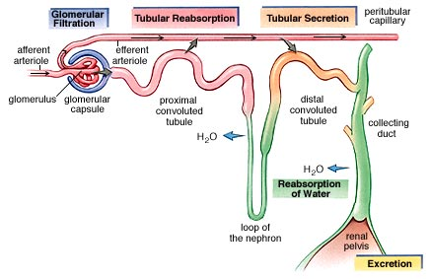

Slide 31
URINE
Anything left in the filtrate such as urea, water, ammonium ions etc drains into the collecting ducts which drain into the renal pelvis & into the ureter.
Once filtrate enters the renal pelvis it is known as urine.
Urine consists of 96% water, 2% urea, 1.5% ions & .5% other (such as drugs).
Urine pushed into bladder by waves of muscular contractions

Slide 32
URINE
Anything left in the filtrate such as urea, water, ammonium ions etc drains into the collecting ducts which drain into the renal pelvis & into the ureter.
Once filtrate enters the renal pelvis it is known as urine.
Urine consists of 1-2L (96%) water, 25g (2%) urea, (1.5%) 15g ions (Na and Cl), 1g uric acid and 1.6g creatinine (0.5%). Little to no glucose or protein is present in urine.
Urine pushed into bladder by waves of muscular contractions
Notes:
Uric acid = metabolism product of purines (broken down nucleic acids) e.g. adenine and guanine
Creatinine = breakdown of creatinine-phosphate an energy rich molecule in muscle

Slide 33
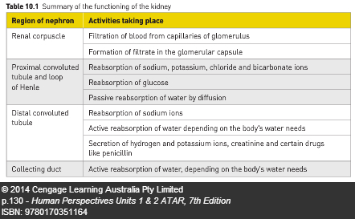

Slide 34
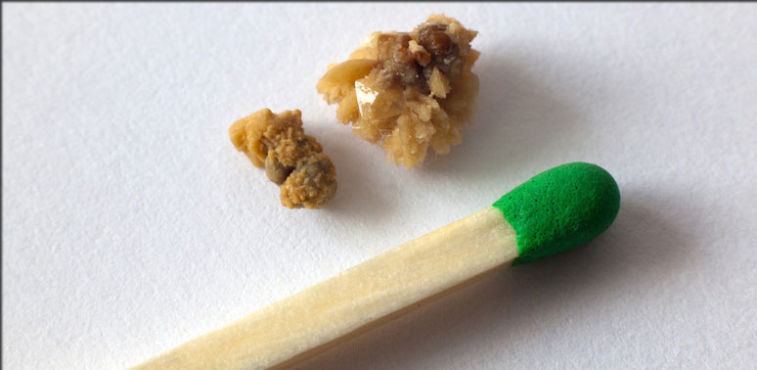
KIDNEY STONES
Build up of solid crystals of highly concentrated urine due to insufficient fluid intake in diet.
Small stones can pass thru ureter and out of body without pain
Larger stones can block and become stuck in ureter, bladder or urethra and cause intense pain.

Slide 35
KIDNEY FAILURE
Failure is the lost ability to excrete waster and control fluid levels.
Most kidney diseases affect renal capsule and reduce filtration ability.
If proteins and erythrocytes leave the blood and present in urine → blood protein (albumin) levels fall → fluid build up in tissues → swelling of hands, feet, face etc.
Maintaining balanced healthy diet and weight reduce kidney diseases
Treatment = dialysis
Notes:
Albumin acts like a sponge in blood vessels to soak up and keep fluid in blood.

Slide 36
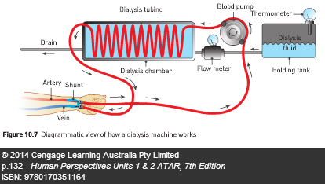
DIALYSIS
Removing wastes from the blood and filtering the blood externally
Peritoneal dialysis – passing of fluid through a catheter into abdominal cavity which contain no waste. Waste in blood with diffuse into fluid due to concentration gradient. Fluid drained out of body
Haemodialysis – fluid is passed through a dialysis machine or artifical kidney.
Notes:
Albumin acts like a sponge in blood vessels to soak up and keep fluid in blood.

